Slide 1
Development and Automated Testing of RESTful APIs Lesson 02
Prof. Andrea Arcuri
Kristiania University College, Oslo, Norway

Slide 2
Implementation
Today we will see how to implement a REST API
Many different languages and frameworks to do it
Kotlin: modern language that compiles to Java bytecode
Spring: the most used enterprise framework in Java
Note: these slides are just high-level overviews… you ll also need to look at the code examples
We will also start to look into Testing

Slide 3
Kotlin

Slide 4
About Kotlin
Recent language: 2011
Java is from 1995
Compile to JVM bytecode (and JavaScript)
High compatibility with Java
Can reuse all tools (eg Maven) and libraries (eg Spring)
Made by JetBrains (same as IntelliJ)
Main language for Android, but also getting common for backend development (eg support in Spring)

Slide 5

Kotlin Island (St. Petersburg)

Slide 6
Why?
Java is a good, solid language, but is verbose and lacks many “modern” features, eg when compared to C#
Things got bit better with Java 8, but that’s 2014
Java still better than C# for enterprise development, but mainly due to its ecosystem (frameworks and libraries)
Due to Google vs Oracle legal fight, Android development was stagnating in a Java 6 wasteland
Java 6 is from 2006, eons in the software development world…
Goal: provide a modern language that can be 100% interoperable with Java

Slide 7
Main Features
Null safety:
Compiler does check if a call to “foo.bar()” might have “foo” null
If a variable can contain null, it has to be marked so
No F*KCING Checked Exceptions…
Removed a lot of boilerplate… code much shorter

Slide 8
public class JavaBase { public boolean startWithFoo(String s) { if(s == null){ return false; } String foo = "foo"; return s.startsWith(foo); } }

Slide 9
//"public" is default scope class KotlinBase { //"public" is default scope fun startWithFoo(s: String) : Boolean //return type is specified at the end after ":" { val foo = "foo" //no need for ";" at the end //type is implicit at compilation time, but you can specify it //if you want, eg: // val foo: String = "foo" /* Do not need to worry of "s.startsWith" throwing a NPE, because compiler checks that caller of "startWithFoo" is not null */ return s.startsWith(foo) } }

Slide 10
Types
Specified after with “:”
Can be left unspecified if compiler can infer them
val foo = “foo”
Note: Kotlin IS statically typed

Slide 11
Var/Val
“var” is for variables that can be modified
“val” are values which are constant
equivalent to the use of “final” in Java

Slide 12
fun bar(){ var foo = "foo" foo = "changed" //foo = null // doesn't compile //note the "?" after the type var bar : String? = "foo" bar = null }

Slide 13
// note the ? fun startWithFoo(s: String?) : Boolean { //doesn't compile //return s.startsWith("foo") //elvis operator return s?.startsWith("foo") ?: false }

Slide 14
fun fiveNextIsFoo(link : Link?) : Boolean{ return link?.next ?.next ?.next ?.next ?.next ?.s?.equals("foo") ?: false }

Slide 15
public boolean fiveNextIsFoo(Link link){ if(link == null || link.next == null || link.next.next == null || link.next.next.next == null || link.next.next.next.next == null || link.next.next.next.next.next == null || link.next.next.next.next.next.s == null){ return false; } //all checks above are necessary to guarantee this //instruction does not throw a NPE return link.next.next.next.next.next.s.equals("foo"); }

Slide 16
public boolean fiveNextIsFooWithCatch(Link link){ try { return link.next.next.next.next.next.s.equals("foo"); }catch (NullPointerException e){ //this is more expensive, as exceptions need //to fill info from stacktrace return false; } }

Slide 17
fun aboutStrings(){ val multiLineString = """ <foo> Some message </foo> """ val x = 5 val s = "Use \$ to interpolate, eg x=$x" print(s) //The print(s) does output the following: //Use $ to interpolate, eg x=5 }

Slide 18
class KotlinConstructor(val s: String, var x: Int) { fun foo() = s + x }

Slide 19
public class JavaConstructor { private final String s; private int x; public JavaConstructor(String s, int x) { this.s = s; this.x = x; } public String foo(){ return s + x; } public String getS() { return s; } public int getX() { return x; } public void setX(int x) { this.x = x; } }

Slide 20
Functional Programming
Kotlin is not as good for FP as Scala, but provides more abstractions/utilities compared to Java
All objects have the methods: let, apply, run, also
Useful when using streams or trying to avoid creating local variables

Slide 21
let, apply, run, also
They are functions that take a lambda as input
Note: in Kotlin, when input is a single lambda, no need for “()”
Return a value: caller itself, or result of the lambda expression
The meaning of “this” and “it” inside the lambda will vary based on the function

Slide 22
Return Lambda Result
Return Caller
also | let
apply | run
Caller as “it”
Caller as “this”

Slide 23
fun createFoo() : Foo{ val foo = Foo() foo.intialize() foo.doSomething() return foo }
fun createFooWithFP() : Foo { return Foo().apply { intialize(); doSomething() } }

Slide 24
More
There is more related to Kotlin
But you do not need to learn all details to be able to be productive in Kotlin

Slide 25
Kotlin Negative Sides
Nothing is perfect, and you will always find different opinions
Eg, minor things I do not like in Kotlin
No ternary operator, eg “return x==5 ? 0 : 1 ”, although in Kotlin “if” is an expression, eg “return if(x==5) 0 else 1”
Poor handling of static methods, but that might change in future releases
Still rough edges regarding typing and generics
Lot of “magic” in Kotlin, so not recommended for total beginners (ie Java is a better introductory language)

Slide 26
Kotlin Major Design Flaw
In Kotlin, classes and methods are final by default
You need to use keyword open to specify they can be overridden
Final by default is a solution to a near non-existent problem
And unfortunately it creates a lot, a lot of problems
eg, when dealing with libraries like Spring and Hibernate
Corollary: do not use Kotlin to write libraries. If a library is written in Kotlin, avoid using it if another equivalent library exists in Java

Slide 27
Kotlin and Maven
We will compile Kotlin to JDK bytecode
We will compile with Maven
there are also plugins for Gradle
Need special plugin to compile Kotlin code
This plugin will need special settings to handle libraries like Spring and Hibernate

Slide 28
Links
Kotlin documentation: https://kotlinlang.org/docs/kotlin-docs.pdf
Kotlin Koans: https://kotlinlang.org/docs/tutorials/koans.html

Slide 29
Spring

Slide 30
Spring Framework
Open-source, first released in 2002
Framework to develop enterprise/web applications
Supported/developed by Pivotal Software
Started as a lightweight alternative to Java Enterprise Edition (JEE)
Now quite complex, but shares/reuses many aspects of JEE
Probably one of the frameworks/libraries with the best documentation out there
eg, see https://spring.io

Slide 31
Why the name “Spring”?
Spring is what comes after the “winter” of JEE…

Slide 32
Spring vs SpringBoot
Spring has many, many modules, like for handling databases, web pages, web services, etc.
To wire together a Spring application, there might be the need to set up a lot of configurations
SpringBoot (2012): part of Spring
Provides convention over configuration
ie, default, reasonable configurations
eg, if you have H2 embedded database as dependency in pom.xml, SpringBoot will automatically start it and configure Hibernate for it
Can write up a full functional enterprise application very quickly

Slide 33
Popularity
Spring is arguably the most popular framework to develop backend enterprise applications
However, like JEE, it has a learning curve, as you need to have a clear understanding of dependency injection and proxy classes
The JDK also has other more lightweight alternatives, like DropWizard
less “magic”, but more boilerplate and less functionalities…

Slide 34
Spring In This Course
Spring is simply huge…
Only going to see/use a tiny subset
Spring-Web: to create REST APIs
Spring-Data: only briefly, as used in some of the examples to access databases
Spring-Cloud: to handle microservices

Slide 35
REST With SpringBoot
You will NOT have a “main” method from which you call your code directly
SpringBoot will start a servlet to handle HTTP calls, eg Tomcat
You will need to write method handlers for the different HTTP calls your API supports
SpringBoot will automatically scan your code to search for the methods handling HTTP calls

Slide 36
Spring Beans
Classes that are handled specially by Spring
When SpringBoot starts, it will scan your code for beans, and initialize them
Beans are identified by annotations:
@RestController: class handling HTTP requests
@Service: bean providing generic business logic
@Repository: bean dealing with database access
etc.
You do NOT instantiate bean classes (eg with new keyword), it is SpringBoot that create them

Slide 37
@RestController class BookRest{ @GetMapping(path = ["/books"]) fun getAll(): ResponseEntity<List<BookDto>> { ...
Example: SpringBoot will create bean for class BookRest, because marked as @RestController
The method getAll will be the handler for all the HTTP requests for URL /books, as marked with @GetMapping
when Tomcat receives a GET for /books, it will call this method to get the results to send back

Slide 38
Entry Point
You need a class annotated with @SpringBootApplication
It will be the entry point of your application
SpringBoot will automatically scan all the classes on your classpath (ie your own classes and all third-party dependencies) to check which beans to start
Be CAREFUL of package names: by default, if @SpringBootApplication is in package X.Y.Z, it will scan only X.Y.Z and sub-packages
ie, X.Y.Z.W is OK, whereas X.Y will be ignored

Slide 39
Spring’s “Magic”
When starting a SpringBoot application, might be difficult to understand what is going on
no clear link from “main” method to your code, and you never instantiate beans directly
What started and initialized depends on @annotations, and what libraries are on your classpath
eg, with Spring-Web, a Tomcat server will be automatically started
Besides knowing the semantics of different @annotations, there are 2 extremely important concepts: proxy classes and dependency injection

Slide 40
Proxy Classes
When having an annotated class Foo, and SpringBoot creates a bean for it, it is NOT going to be a direct instance of Foo, but rather a proxy
A proxy for Foo is a class that extends Foo, where all methods can be enhanced
A proxy can have a code before and after the original methods of Foo (all methods are overridden)
example: methods marked with @Transactional will automatically start and then commit transactions

Slide 41
Anatomy of a Proxy Class
The proxy would be automatically generated by Spring at runtime
public class FooProxy extends Foo{ private final Foo original; public FooProxy(Foo original) { this.original = original; } @Override public String someMethod(){ // do something before, eg start a transaction String result = original.someMethod(); //do something after, eg, commit the transaction return result; } }
public class Foo { public String someMethod(){ return "foo"; } }

Slide 42
Dependency Injection (DI)
What if a bean A needs to call functionality of a bean B?
A cannot create an instance of B
A has to ask SpringBoot to get an instance of B
2 methods for DI
Field Injection: fields marked with @Autowired will be automatically initialized after the bean is created, using Reflection
eg, @Autowired private B b;
Constructor Injection:
reference of B passed directly in the constructor of A, where Spring provides the right value when creating a bean for A

Slide 43
Configurations
SpringBoot provides sensible default configurations based on what present on your classpath
If you need to do modifications, those will be in a application.properties or application.yml file
those are the same, just in different formats
“.properties”: pairs <property-name>=<value>
“.yml”/“.yaml”: YAML (YAML Ain't Markup Language)
See following for list of properties:
https://docs.spring.io/spring-boot/docs/current/reference/html/common-application-properties.html

Slide 44
Software Testing

Slide 45




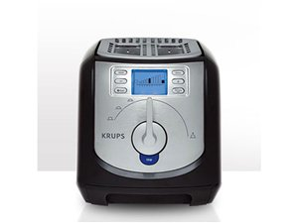







Software is everywhere!!! (not just enterprise systems…)

Slide 46
Are software applications doing what are they supposed to do?

Slide 47


Ariane 5 – ESA
On June 4, 1996, the flight of the Ariane 5 launcher ended in a failure.
$500 millions in cost
Software bug

Slide 48

Fatal Therac-25 Radiation
1986, Texas, person died

Slide 49

Power Shutdown in 2003
Nearly 50 million people affected in Canada/US

Slide 50
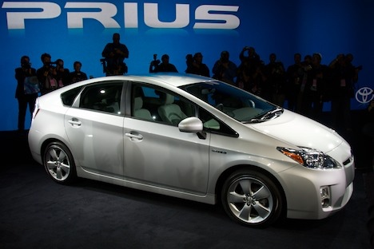
2010, Toyota, bug in braking system, recalled 436,000 vehicles…

Slide 51
Knight Capital Group 2012
$460 millions lost in 45 minutes of trading due to bug

Slide 52
And I could go on the whole day…
As of 2013, estimated that software testing costing $312 billions worldwide
In 2016, 548 recorded and documented software failures impacted 4.4 billion people and $1.1 trillion in assets worldwide

Slide 53
Why??? A common problem… no tests!

Slide 54
Software Testing
Software has bugs, ie implementation mistakes
All developers write bugs, not just students, even senior developers
eg, in the writing of the code of this course there were (and might still be) several bugs, which you can check by looking at the commit logs in the Git history
Testing helps you to find bugs before it is delivered to customers
However, testing does NOT guarantee the absence of bugs…

Slide 55

Manual Testing
Start the application you are developing
Use it, and manually check if it is working correctly
eg, should not crash and should get expected behavior
Try to follow common usage scenarios for the application
Also try uncommon scenarios, to check if still working correctly
Software Tester: an employee whose work is to test the application before each new release/feature

Slide 56
Problems of Manual Testing
Many people finds it boring…
It is not systematic: a manual procedure can miss/forget to test important scenarios and edge cases
It is expensive: software testers still need a salary to feed their families…
Every time there is a code change, new bugs might be introduced, and previous testing is invalidated
ie, have to do it again, and again, and again, and …
Still, you need to have a manual testing phase (eg before a major release to customers), but you also need something more besides manual testing

Slide 57
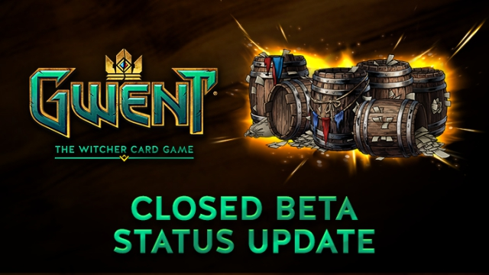

Beta Testing
A type of manual testing you might be familiar with, especially in regards to video-games
Release the software in a “beta” state to a group of potential users, which will test it for free!
Very common in online games, especially to test large loads on servers before a main release

Slide 58
Testing Depends on Context
If there is a bug in a video-game, players will just have a to wait for a patch…
although if too many bugs at launch, it will hurt sales…
If there is a bug in an enterprise system dealing with critical assets (e.g., a bank), you might be screwed…

Slide 59
Automated Testing
Write code that can automatically run tests against an application, or parts of it (e.g., single functions or classes)
Benefits:
you can test single parts of the application
can re-execute all tests every time there is a code change to see if these new changes break current functionalities

Slide 60
Kinds of Testing
Unit Testing
test units (functions/classes) in isolation
Integration Testing
scenarios in which different components are involved
System Testing / End-to-End (E2E) Testing
test the whole application, going through the same interfaces (e.g., a GUI) that a user would use to interact with it
But there are many others
User Testing, Security Testing, Performance Testing, Robustness Testing, etc.

Slide 61
Running Tests in Java
The main framework is JUnit
others are like for example TestNG and Spock
Not just for unit testing, but any kind of testing
eg, the Arquilliain and Spring service tests can be considered as integration tests

Slide 62
Maven and Tests
Maven can run tests as part of the build
It makes distinctions between unit and integration tests
But these are JUST names, and NOT necessarily related to the concepts of unit and integration testing
ie, could run unit tests in Maven like they were integration ones
unit: run by Surefire plugin, name pattern “*Test.java”, executed BEFORE the “mvn package” phase (jar/war file not built yet)
integration: run by Failsafe plugin, name pattern “*IT.java”, executed AFTER “mvn package” (so can use the built JAR/WAR file)

Slide 63
When to use “*IT.java”
If your tests need to use the generated JAR/WAR file
eg, you want to start the actual built application
If your tests are long to execute (e.g., system tests), and you do not want to run them each time you just need to do a “mvn package”
eg, you just want to quickly build the application for some manual testing, although you still want to run the quick unit tests, just in case…

Slide 64
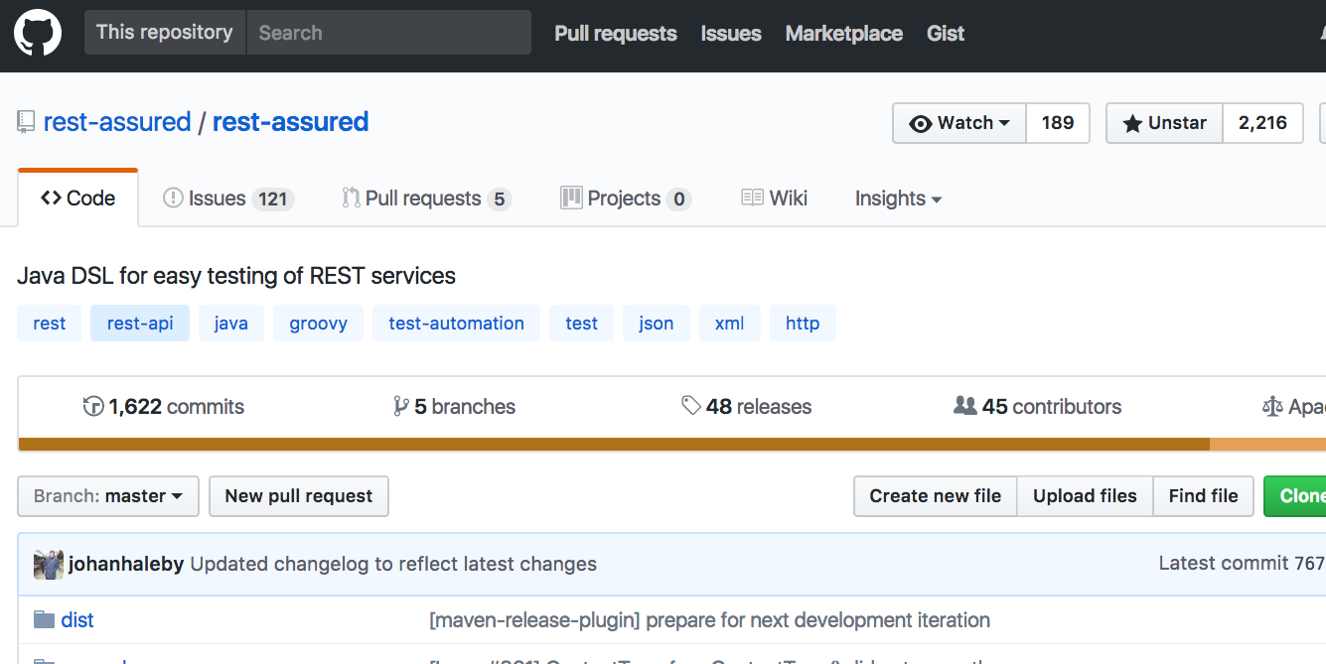
E2E Testing of REST APIs
Do HTTP calls, read responses
Specialized libraries, eg in Java the popular RestAssured
Setup database states
before: add test data
after: clean state
There can also be other environment entities to handle
eg, connection to other services
@Test
public void test0() throws Exception {
given().header("Authorization", "ApiKey user")
.accept("*/*")
.get(”www.foo.com/api/v1/media_files/42”)
.then()
.statusCode(200);
}

Slide 65
Automated Test Generation
Writing E2E tests for REST APIs can be tedious
Research Goal: develop techniques to automate the generation of those tests
We will see how the tool EvoMaster tries to achieve it
we start using it today, but will see details later in the course

